Slide 1
Academic Plagiarism Detection: A Systematic Literature
Review Publication:ACM Computing Surveys (October 2019)
Authors:
TOMÁŠ FOLTÝNEK, Department of Informatics, Mendel University in Brno, Czechia and University of Wuppertal, Germany
NORMAN MEUSCHKE and BELA GIPP, University of Wuppertal, Germany and University of Konstanz, Germany
Presented By:
201911020 (Keval Rajyaguru)

Slide 2
Paper Selection
Introduction reading of some Papers:
Change Detection of Web Pages: A Survey
Document Layout Analysis: A Comprehensive Survey
Extraction and Analysis of Fictional Character Networks: A Survey
Unsupervised Approaches for Textual Semantic Annotation, A Survey

Slide 3
Paper Selection
Motivation to finalize this Paper:
reviewing 239 research papers after visiting almost all papers published between 2013 and 2018 related to this Topic
Known Preprocessing NLP approaches and Retrieval methods like LSA, SVD, log-weighted tf-idf.
Combinations of different methods and approaches used in other papers are represented sequentially
Step by step evaluation

Slide 4
Source Selection
keyword-based automated search using Google Scholar and Web of Science
search period to 2013 until 2018 (including)
some seminal papers regardless of their publication date.
Google Scholar:
Indexes major computer science literature databases, including IEEE Xplore, ACM Digital Library, ScienceDirect, SpringerLink, and TandFonline, as well as grey literature.
system’s relevance ranking
Web of Science:
To Cover the most influential papers on academic plagiarism detection: relevance ranking of Google Scholar and ranked search results from Web of Science by citation count

Slide 5
Source Selection
Paper Collection in Five Phase:
First Phase: sought to include existing literature reviews on plagiarism detection for academic documents
Google Scholar queried using some keywords :
plagiarism detection literature review, similarity detection literature review, plagiarism detection state of art, similarity detection state of art, plagiarism detection survey, similarity detection survey
Second Phase: added topically related papers using the following rather general key-words:
plagiarism, plagiarism detection, similarity detection, extrinsic plagiarism detection, external plagiarism detection, intrinsic plagiarism detection, internal plagiarism detection

Slide 6
Source Selection
focused search on plagiarism detection for text documents
Third Phase: Data Collection and sub-topics queried in google-scholar.
Semantic analysis plagiarism detection, machine-learning plagiarism detection.
Fourth Phase: prevent selection bias - Querying Web of Science using the keyword plagiarism detection
Fifth Phase: Added Topically Related Papers from collection to dataset Papers and included relevant references of collected papers and papers that publishers’ systems recommended as related to papers in our collection.

Slide 7
Source Selection
By following five phase procedure they included notebook papers of the annual PAN and SemEval workshops. To ensure the significance of research contributions, they excluded papers that were not referenced in the official overview papers of the PAN and SemEval workshops or reported results below the baseline provided by the workshop organizers. For the same reason, they excluded papers that do not report experimental evaluation results.

Slide 8
Observations
Three Broad interdependent categories: plagiarism detection methods, plagiarism detection systems, and plagiarism policies.
Many authors agreed on classifying idea plagiarism as a separate form of plagiarism
Pairwise comparisons of the input document to all documents in the reference collection are often computationally infeasible, so candidate retrieval is the most important task for Extrinsic Plagiarism Detection.
Author Clustering typically follows the style breach detection stage and employs pairwise comparisons of passages to group them by author

Slide 9
Observations
Intrinsic plagiarism detection, limit preprocessing to a minimum to not loose potentially useful information, intrinsic detection methods typically do not remove punctuation.
VSM (Vector Space Models) remain popular and well-performing approaches not only for detecting copy-and-paste plagiarism but also for identifying obfuscated plagiarism as part of a semantic analysis
Detection approaches implementing the general impostors method achieved excellent results in the PAN competitions, e.g., winning the competition in 2013 and 2014 .
LSA can reveal similarities between texts that traditional vector space models cannot express. The ability of LSA to address synonymy is beneficial for paraphrase identification

Slide 10
Observations
When applied for document classification, ESA(Explicit Semantic Analysis) achieved a precision above 95%
Knowledge graph analysis(KGA) achieves high detection effectiveness if the text is translated literally; for paraphrased translations results are more effective
Unsupervised and supervised machine-learning methods have found increasingly wide-spread adoption in plagiarism detection research and significantly increased the performance of detection methods.
the prediction based methods outperformed their count-based counterparts in precision and recall while requiring similar computational effort

Slide 11
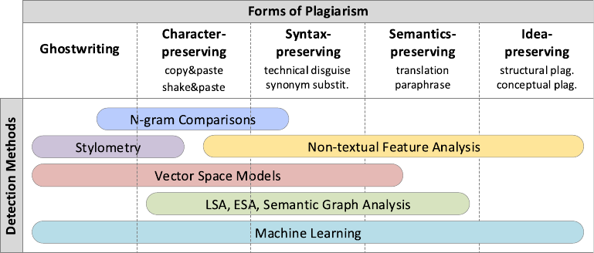
Summary

Slide 12
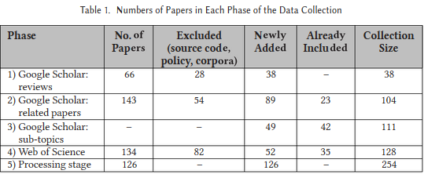
Summary
As mentioned Earlier the paper includes methods and conclusion from more than 200 papers. In this paper five phase were used to get the dataset.

Slide 13
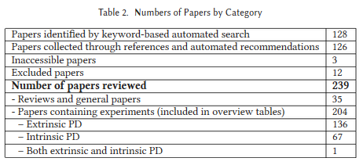
Summary
multi-faceted and multi-stage approach to data collection yielded a set of papers that comprehensively reflects the state of the art in detecting academic plagiarism.

Slide 14
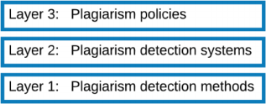
Summary
This survey shows classification of dataset by different methods and application.
It contains three layered model to address academic plagiarism.
It gives definition of various Plagiarism Typologies included in this paper and different forms of plagiarism.
Each forms are described with relevant research.
Some analysis and implementations are also mentioned

Slide 15
Summary
Plagiarism Detection approaches and various methods to implement approaches
Preprocessing and Text Retrieval –> n-grams, vectorizer, words etc.
Evolution in Plagiarism Detection
Plagiarism Detection Systems -> Web-Based, Software

Slide 16
Summary
Satisfied four questions Kitchenham et al. suggested to assess the quality of literature reviews
Article summarizes previous research and identifies research gaps to be addressed in the future.
This review will help researchers newly entering the field of academic plagiarism detection to get oriented as well that it will help experienced researchers to identify related works.
Findings will aid in the development of more effective and efficient plagiarism detection methods and system that will then facilitate the implementation of plagiarism policies.

Slide 17
How this survey is cited in future literature
Forms of Plagiarism in Digital Mathematical Libraries
the advancement of information technology has made plagiarizing easier than ever
To speed up the comparison of fingerprints, some approaches hash or compress the fingerprints, which reduces the lengths of the strings to compare and allows for computationally more efficient numerical comparisons
academic plagiarism causes a significant waste of resources
Detecting Machine-obfuscated Plagiarism
Researchers who plagiarize can inﬂate their publication and citation counts, secure research funding for the ideas of others, and advance to job positions for which they are not qualiﬁed

Slide 18
An implementable component:
All most all the content in this survey is results and analysis of another papers. And every analysis is result of manual study.
One implementation related to this paper can be automation search on web
Some methods are discussed in survey are abstract ongoing implementation of another papers.
e.g. Detailed analysis
i.e. Let dq be a suspicious document. Let D = {ds}|s = 1...n be a set of potential source documents. Determine whether a fragment sq ∈ dq is similar to a fragments ∈ds (ds ∈ D) and identify all such pairs of fragments (sq, s)
e.g. Author Clustering
i.e. for a given set of documents or passages D, the task is to find the decomposition of this set D1, D2,...Dn, such that:
1. D = UDi for i=1...n
2. Di ∩ Dj = ∅ for each i j
3. All documents of the same class have the same author; For each pair of documents from different classes, the authors are different.

Slide 19
Concepts I did not understand in the first round of reading
Terms and Techniques, context specific words, tracing of concepts
Resolved that in subsequent round of reading
Web Search, Using Bibliography

Slide 20


Thank You

